Slide 1





Data
Analysis
Presentation 2023
Online (E–Commerce) Platform
Capstone Project 4
Presented By:
Prem Kumar

Slide 2







Outline
Problem Statement
Objective
Solution
Conclusion

Slide 3



Agenda
∙ Problem statement
∙ Campaign Goals
Data Preparation
Sales Trend
Customer Trend
Top 10 products and bottom 10 Products
Forecast and Target
Let’s Conclude
Questions?

Slide 4




Problem Statement
The company aims to build a robust customer base, elevate customer satisfaction, offer personalized product recommendations, and boost revenue generation as outlined in the provided information.

Slide 5



Company Goals
Increase the number of loyal and engaged customers through various strategies, such as marketing campaigns and customer acquisition initiatives.
Implement algorithms and systems that provide tailored product recommendations to each customer, increasing the likelihood of purchase and cross-selling.
Boost company earnings through a combination of growing the customer base, enhancing the customer experience, and increasing the average transaction value by promoting relevant products.
02
03
Build a Strong Customer Base
Personalized Product Recommendations
Increase Revenue

Slide 6


Data Cleaning
Understanding the data
Changing Data Type
After understanding the data , next will be data preparation for a better quality data to get proper insights for conclusion.
Data
Preparation
Adding & Deleting
Column
Add custom column
Add Table
Data Grouping

Slide 7

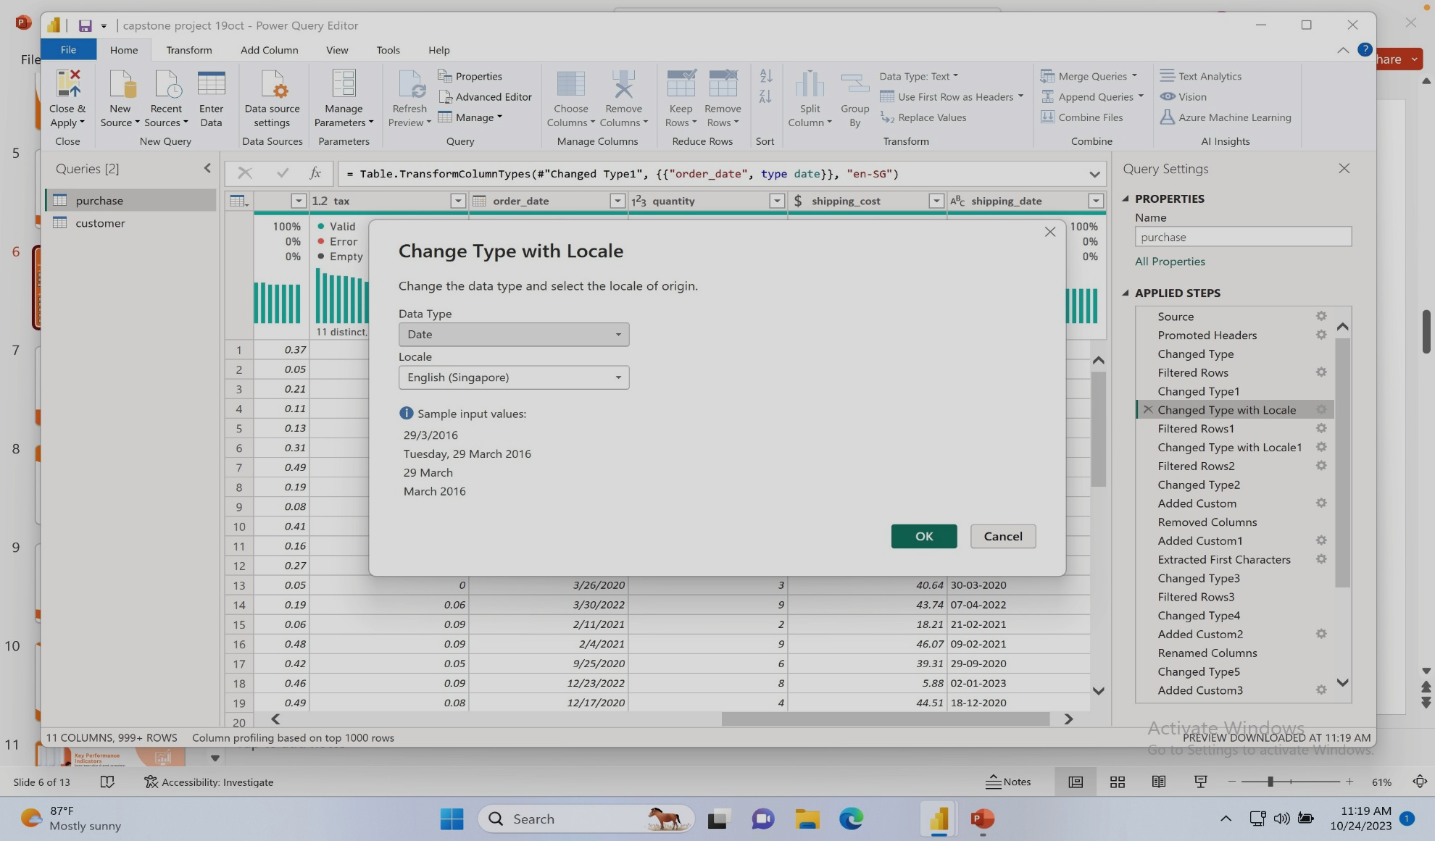
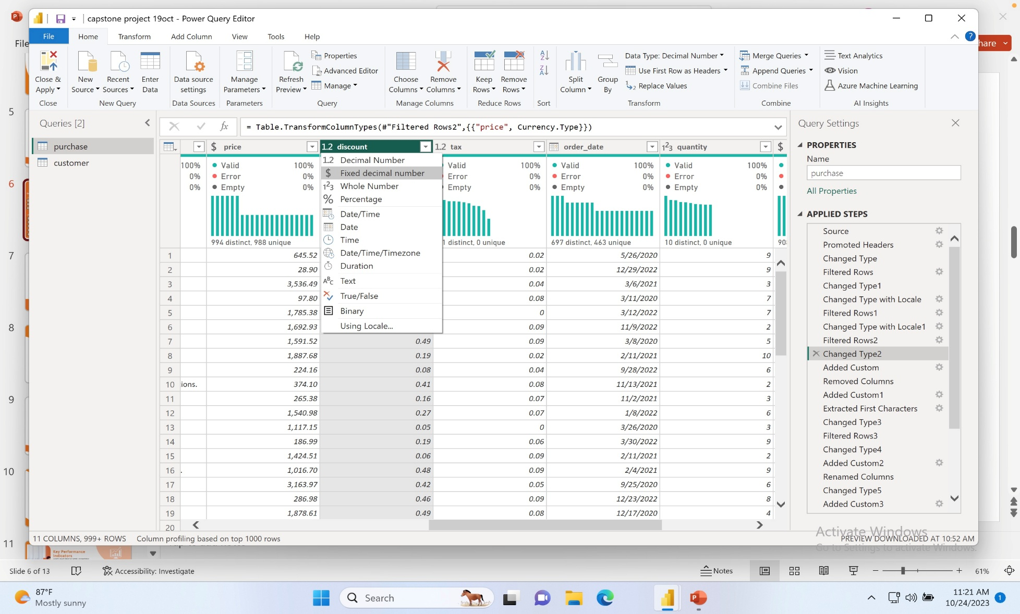
Changing Data Type
Changing to Date to Locale Type
Changing to Fixed Decimal places
Certain column had to change to Fixed decimel places, but not all and date column was not standardize so made changes appropriately.

Slide 8
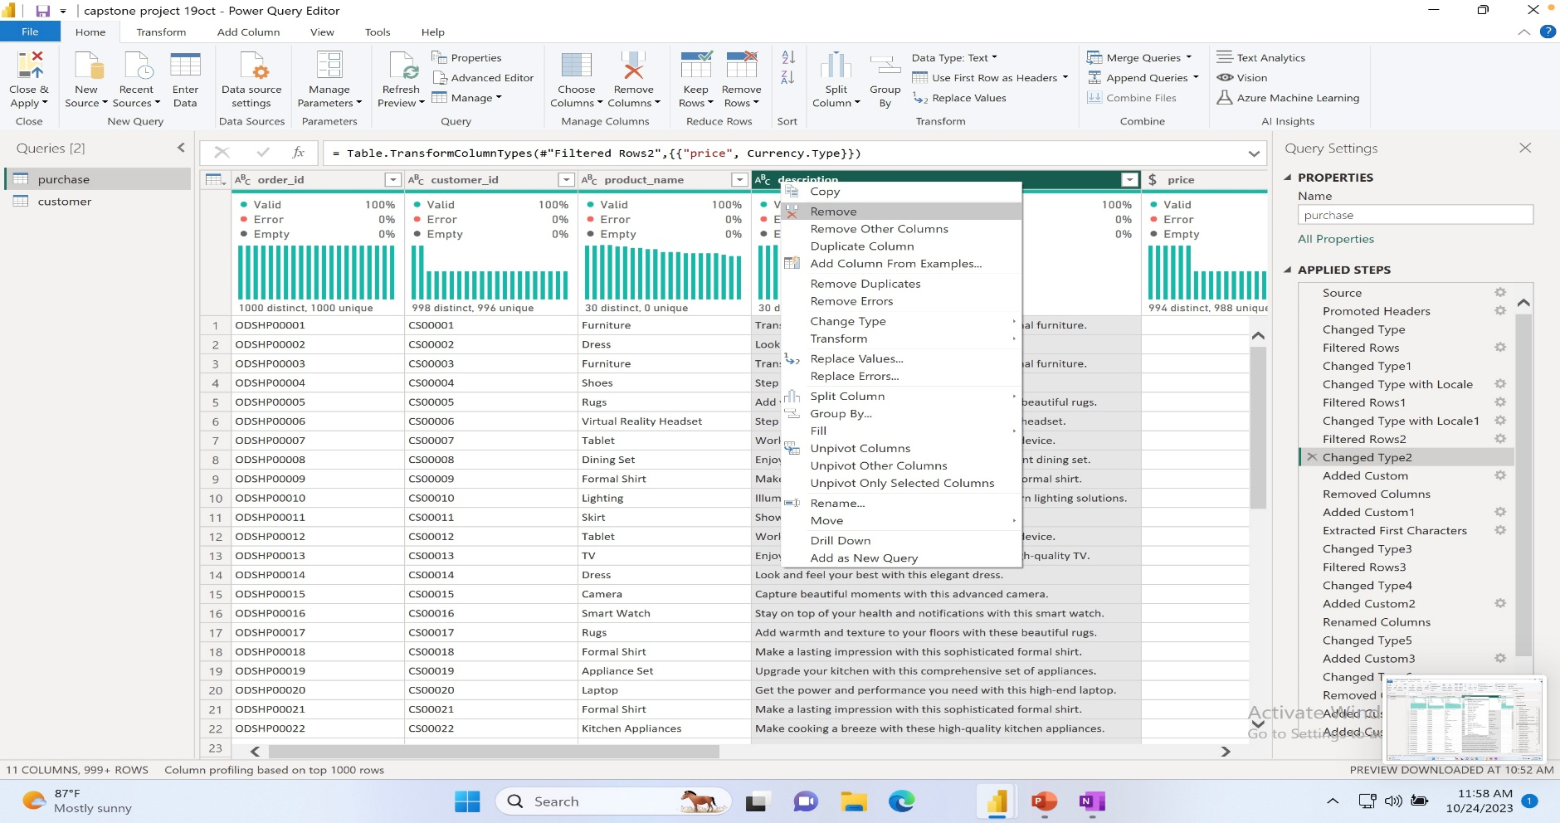
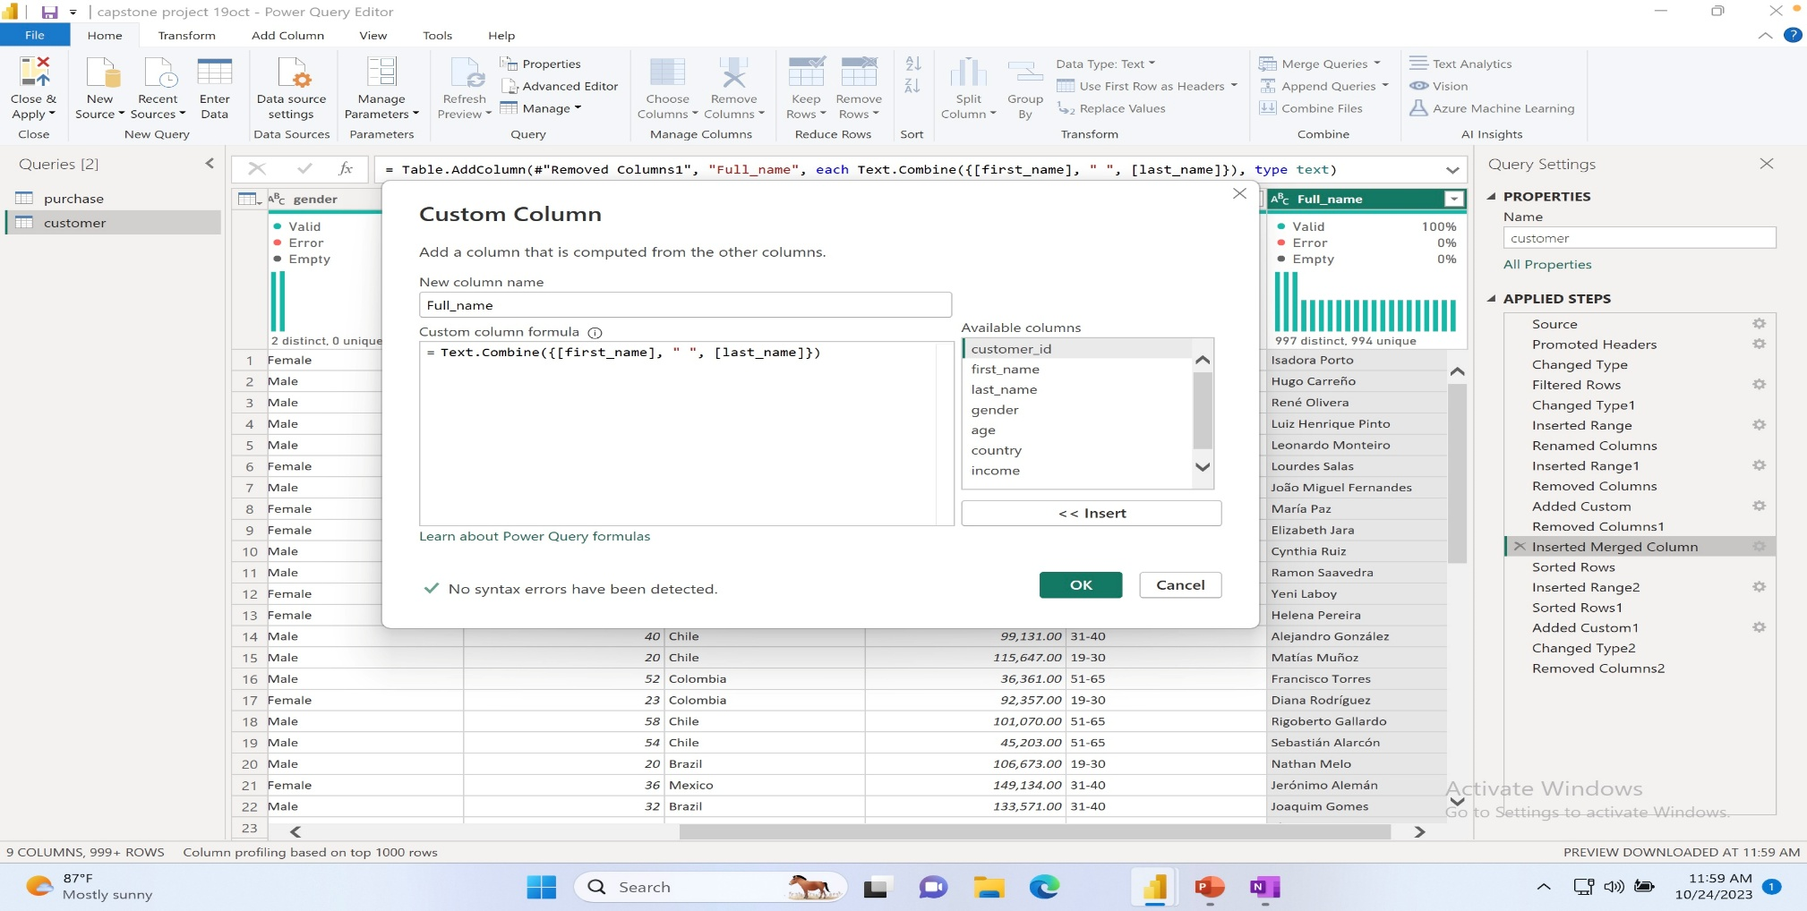
Adding and deleting column
Deleting Description Column
Merging First and Last name
Deleted Description column because it had no meaning for my intended insight, and getting fullname of customer would be easier to fliter.

Slide 9
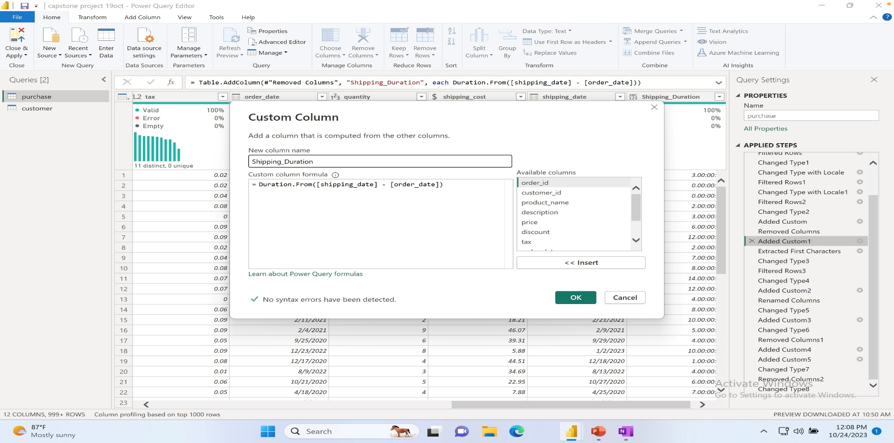
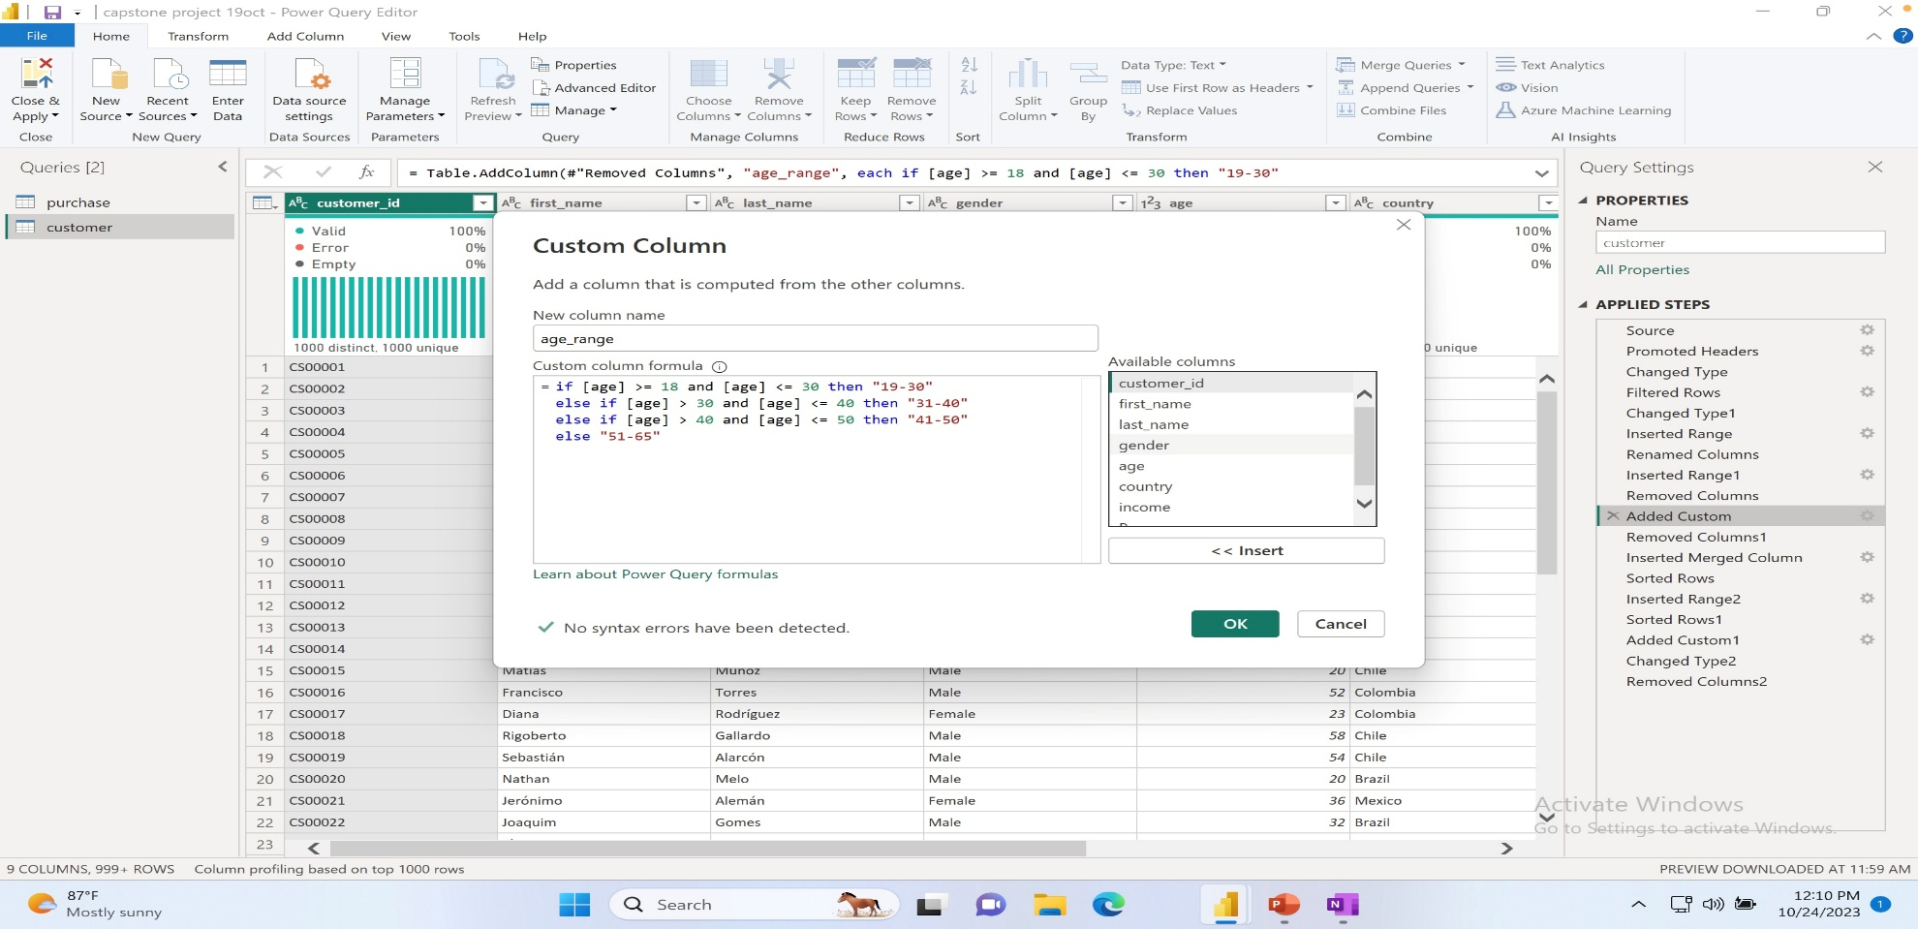
Adding and Custom column
Added Custom Column
for shipping duration
Added Custom Column For Age range
And group them according
Shipping Duration will let me know how long does it takes to ship. Age range will help to get to know more about customer trend by age.

Slide 10
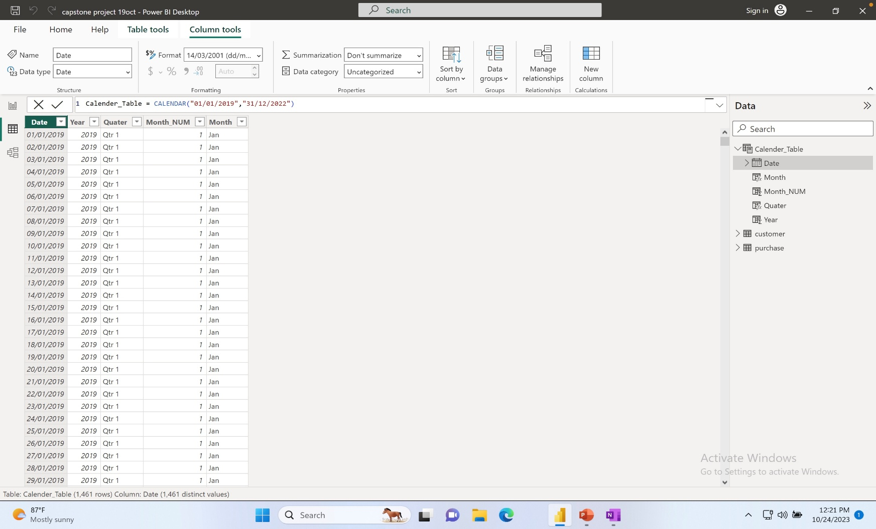
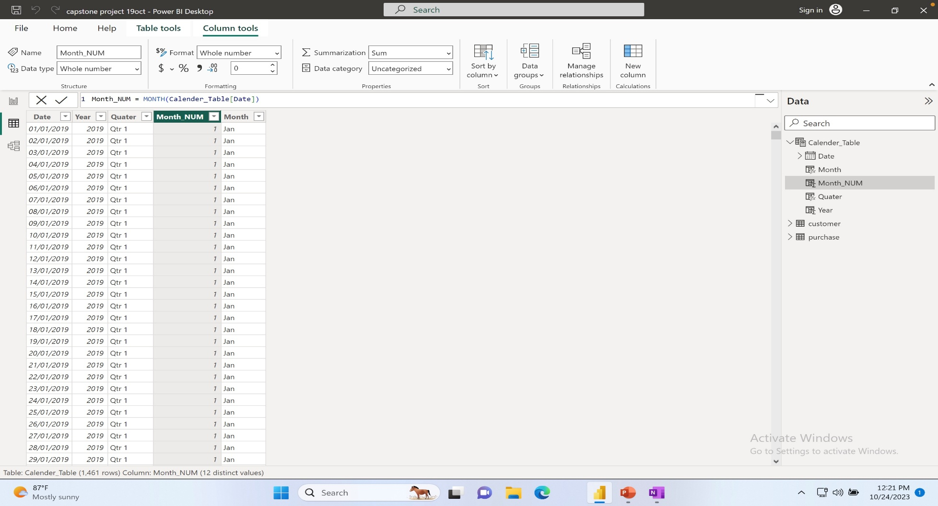
Adding Date Table
Created a Date Calender Table
Created Year, Quarter, MonthNum
And Month name column
Only had Order and Ship date column so created a Calender table for easier access on sales insights.

Slide 11
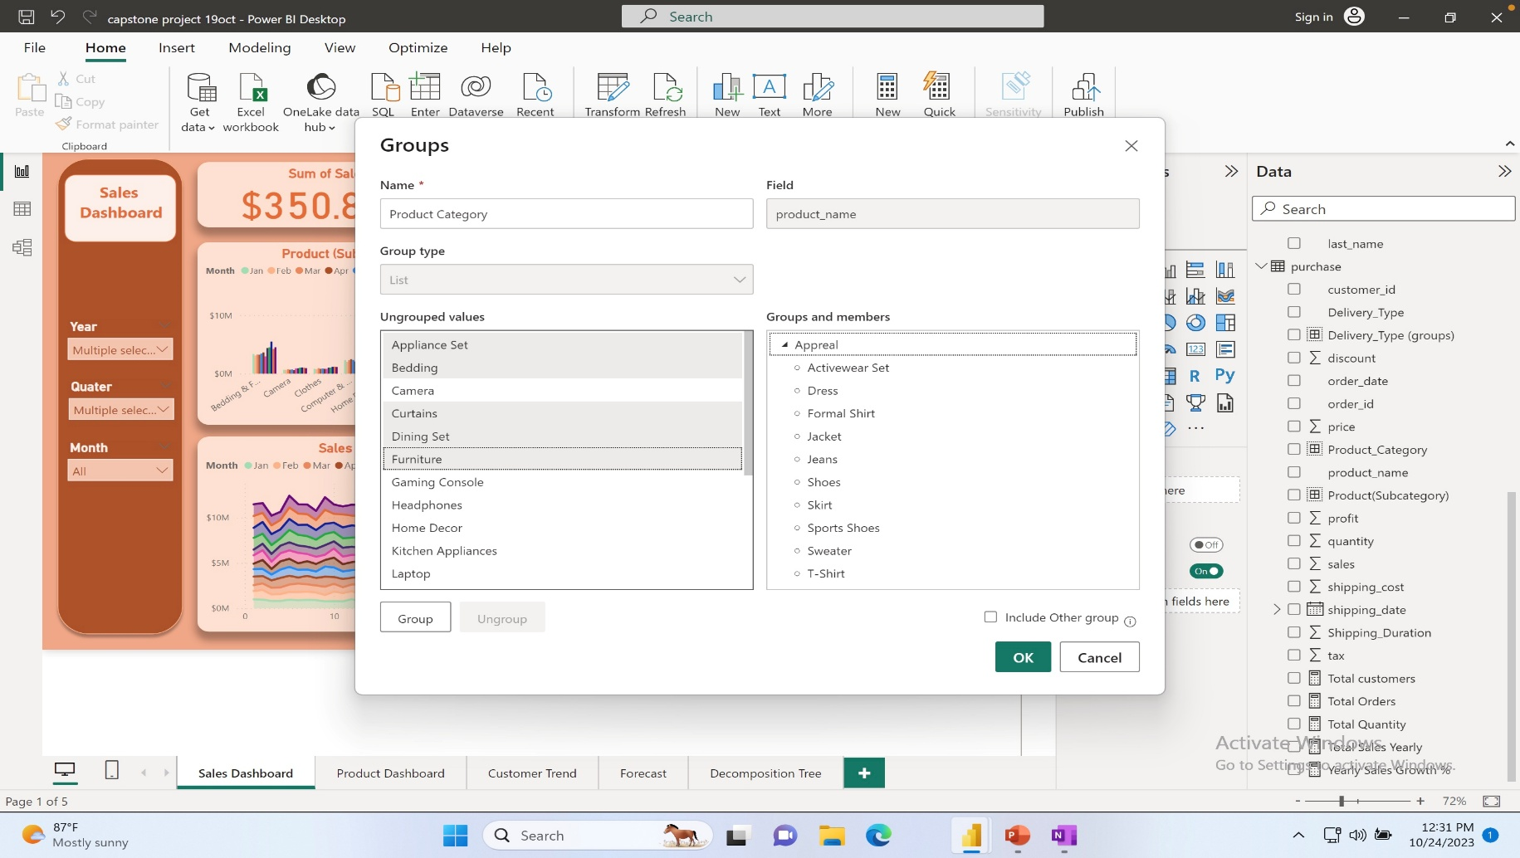
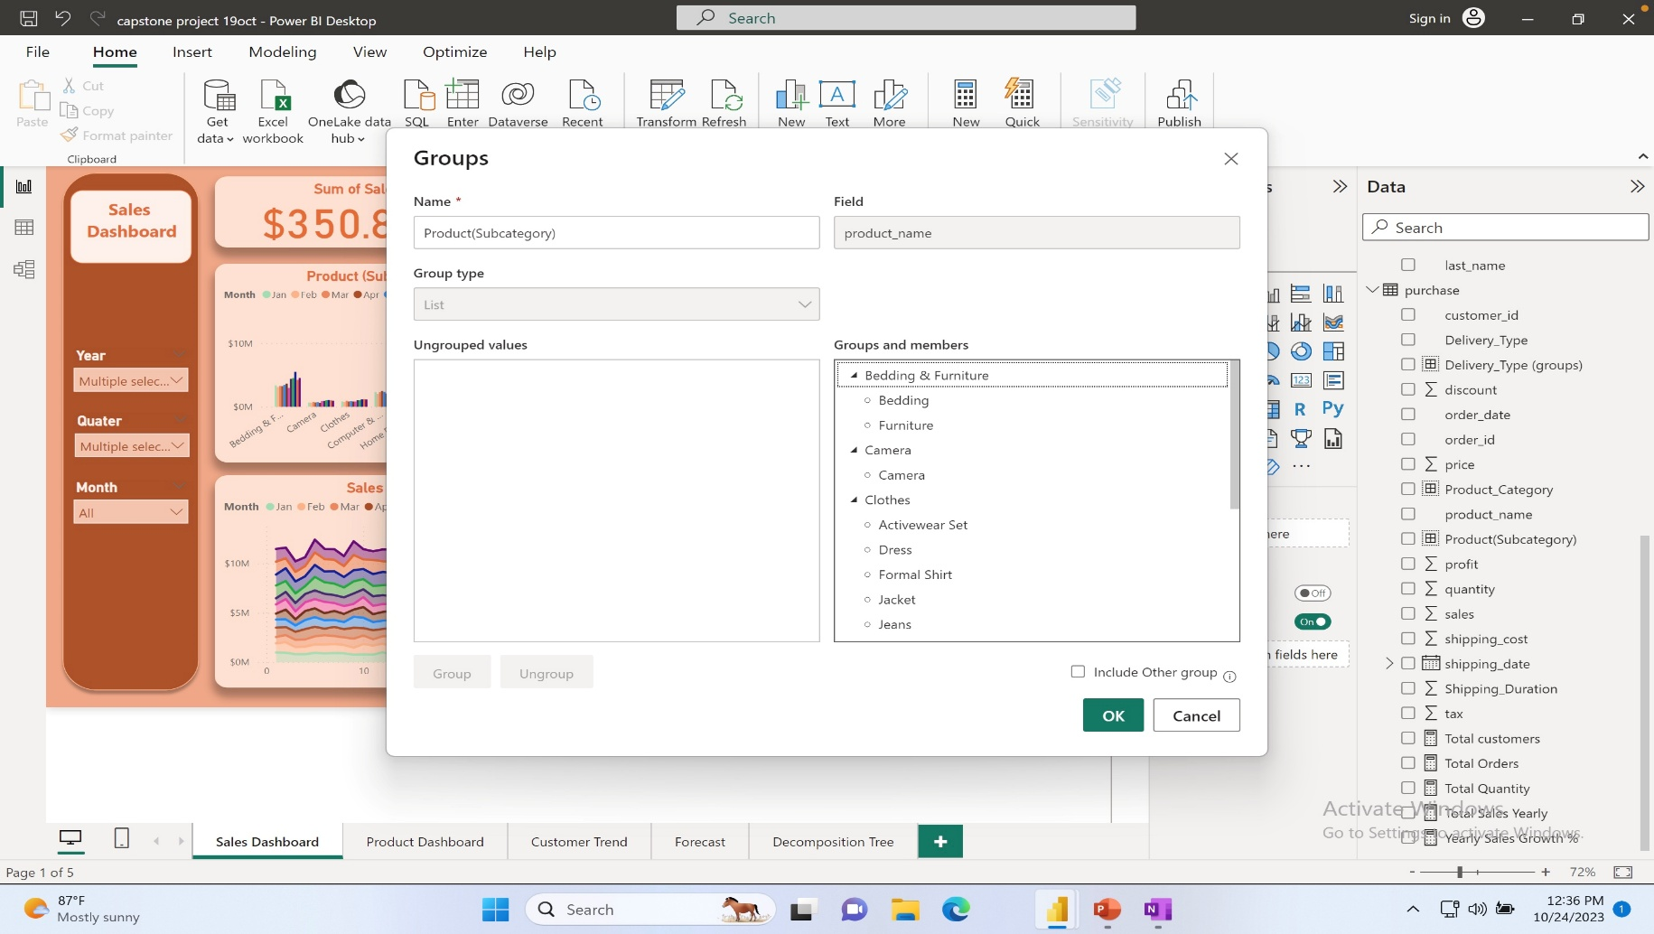
Data Grouping
Grouping Product name in Category
Grouping Category in Sub-Category
There were 30 products so had to group them
In 10 sub-category and 3 main category.

Slide 12
Let’s Start!
Let’s start to see some of the
Insights and look at their solutions.

Slide 13

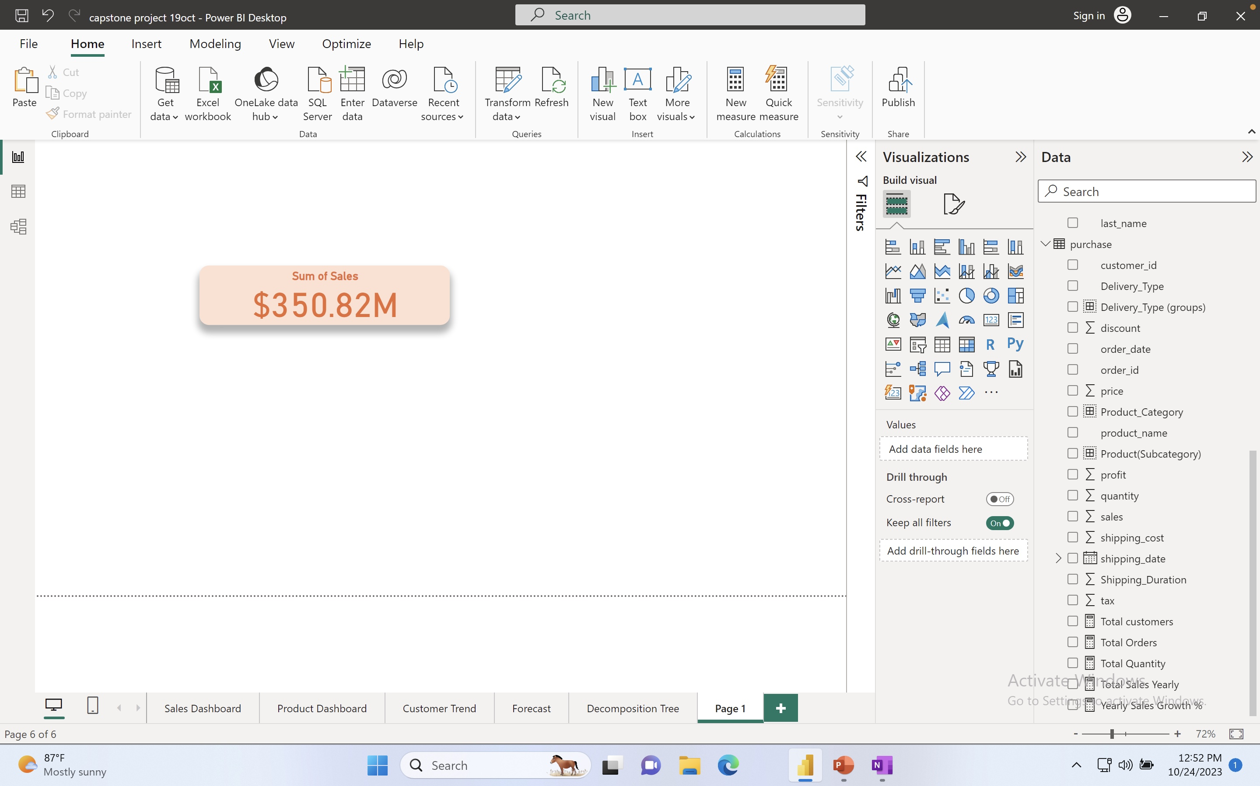

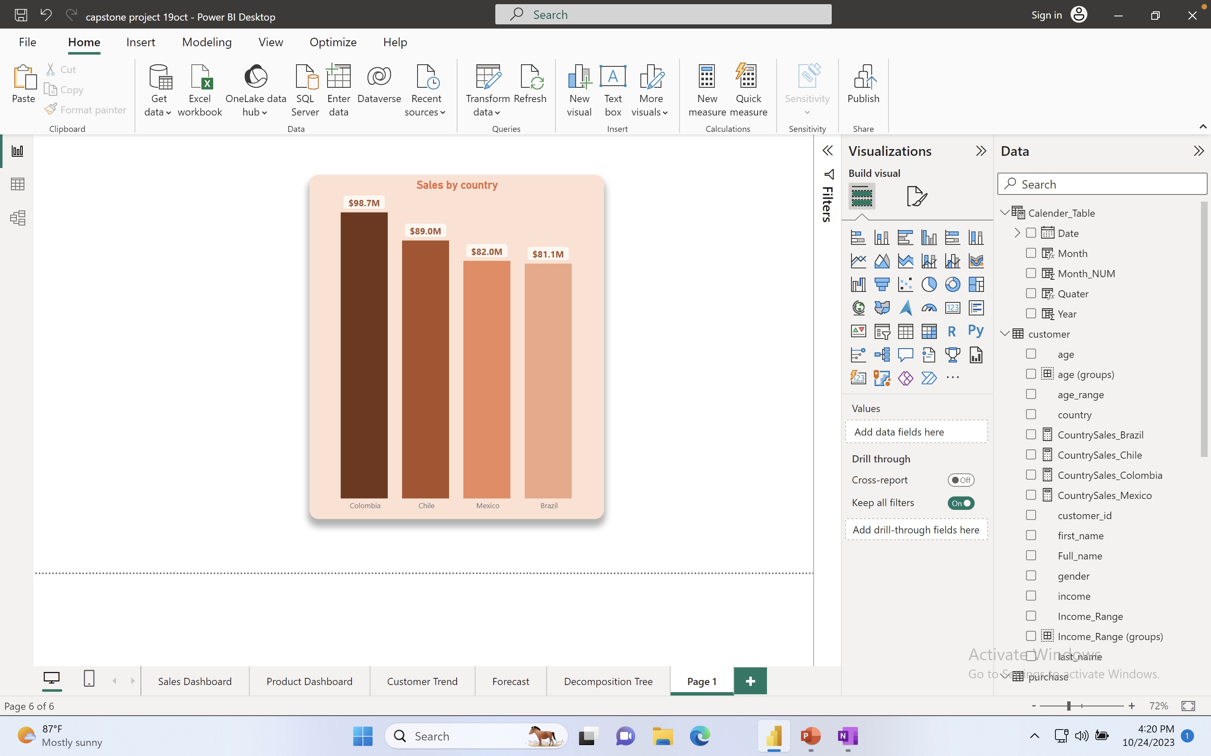
Sales Trend by Country
Total sales of the four countries will be $350 million.
01
Colombia Leads with 98.7m.
02
2nd Chile with 89m.
03
3rd Mexico with 82m
04
Last Brazil with 81.1m

Slide 14
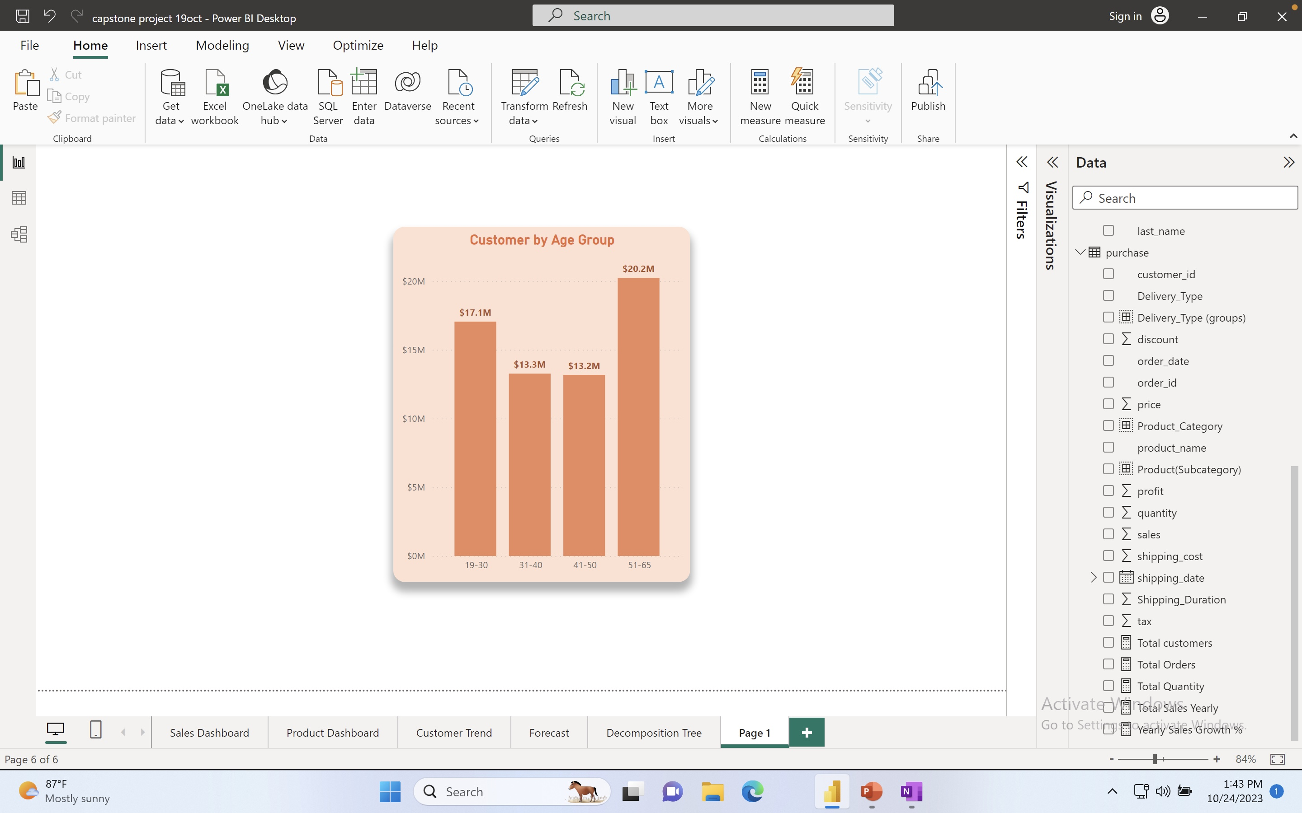
Customer Trend By age
What are the customer Trend by Age Group?
01
51 – 65 years old is the highest buying customer
02
Followed by 19 -30 years
03
Last will age group
(31-40) and (41-50)
Coming in almost with the same sales value.

Slide 15
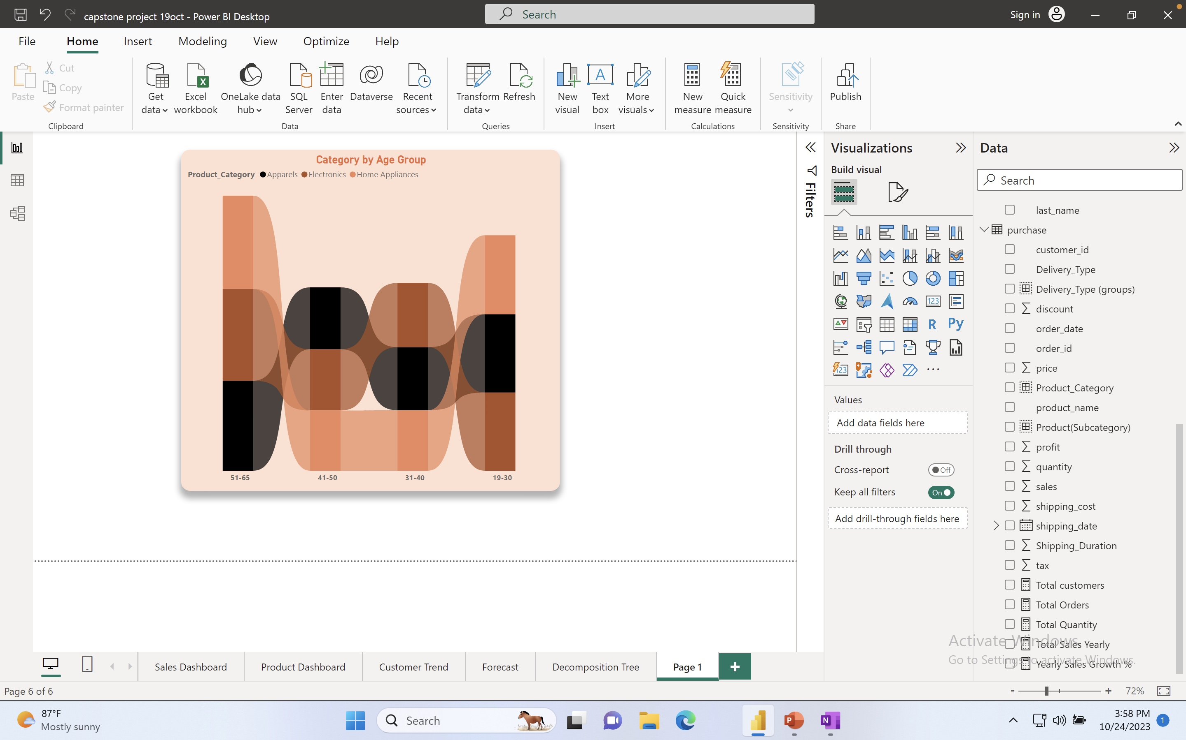
Customer age group by Category
Most Preferable Category by
Age Group
01
Home Appliances is the highest among
(51-65) & (19-30).
02
Electronis sale is highest among (31-40).
03
41 – 50 age group buy more on apparels

Slide 16
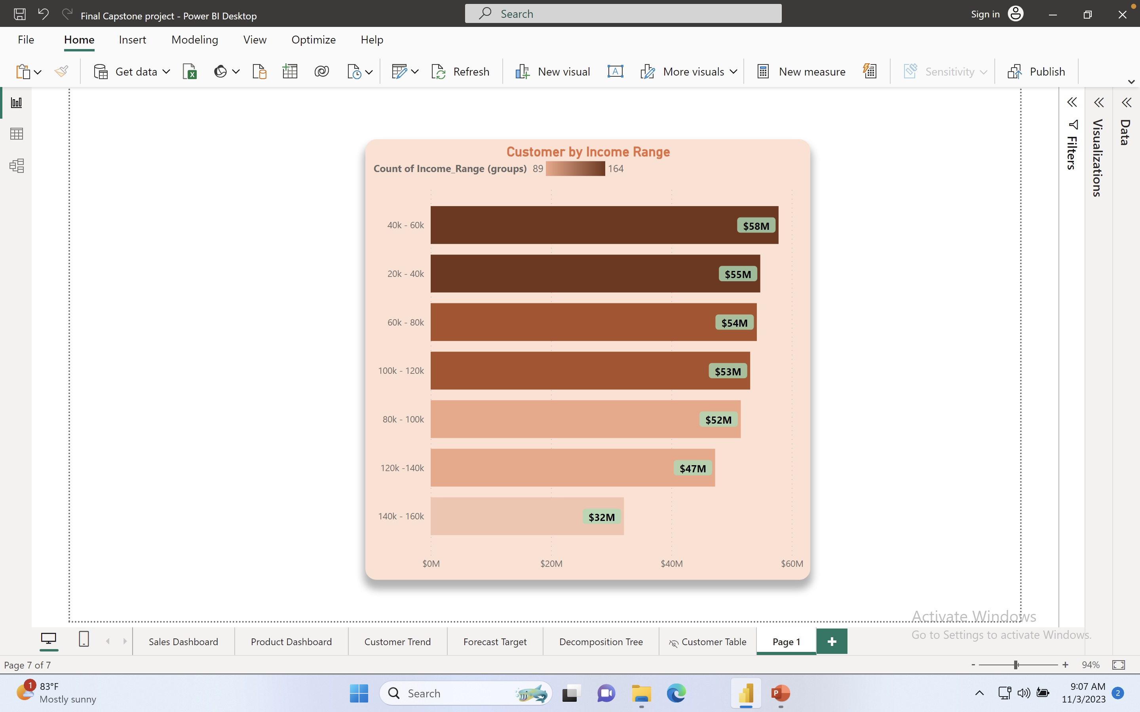
Customer
Trend by
Income
Do the Highest earning buy more?
01
Apparently, people who are earning
(40-60k) and
(20 – 40k) Per Year are the with the most sales
02
The Highest earning has the lowest amount of sales

Slide 17
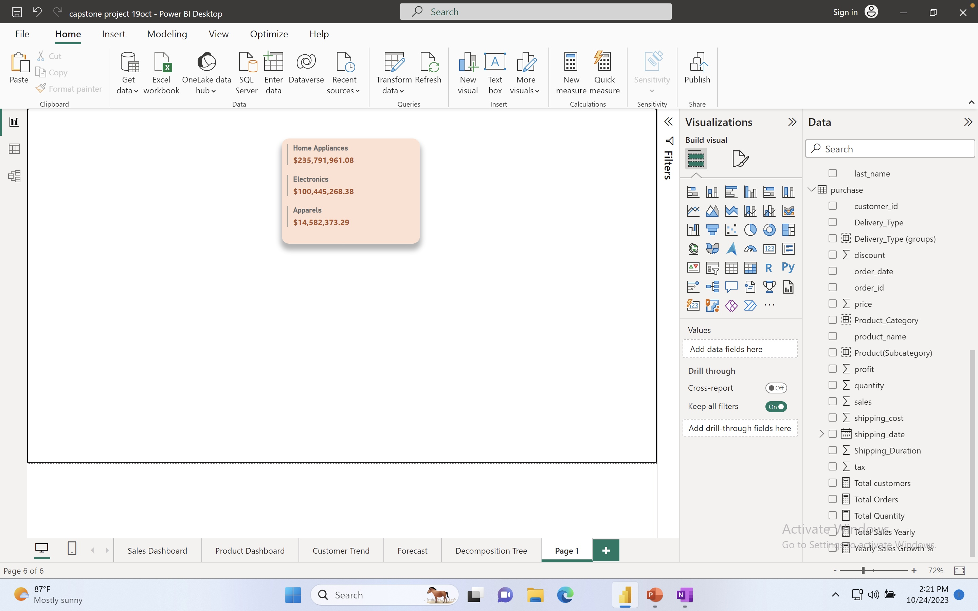
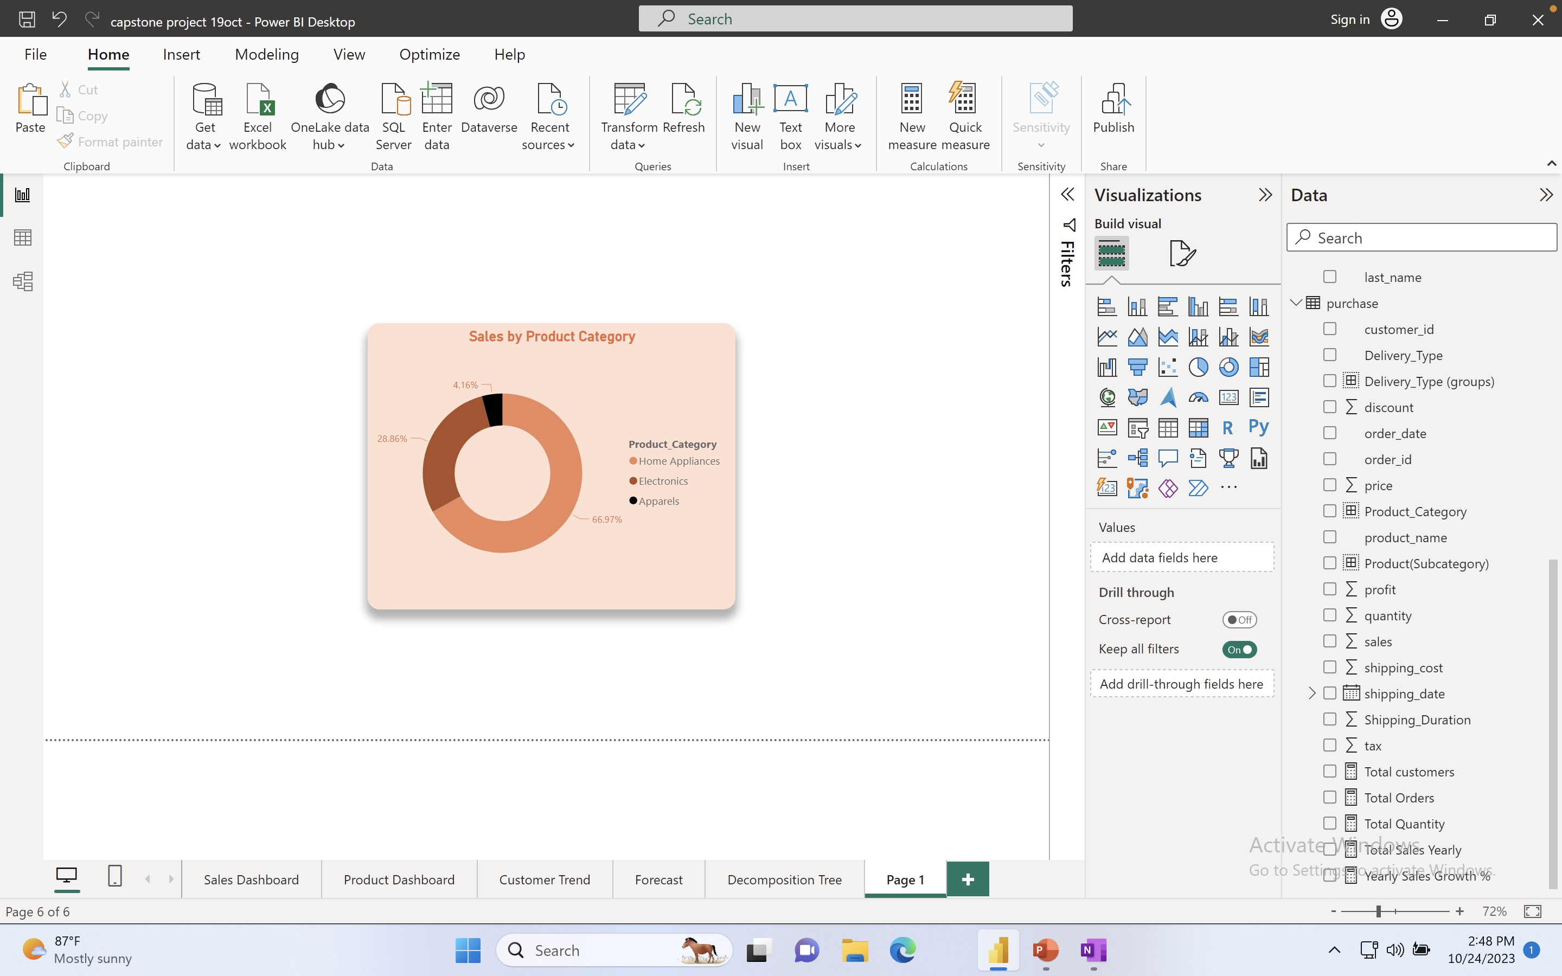
Sales By
Product Category
Which Product is the best ?
01
In category, Home appliances has the highest sales
02
Followed by Electronics then Apparels

Slide 18
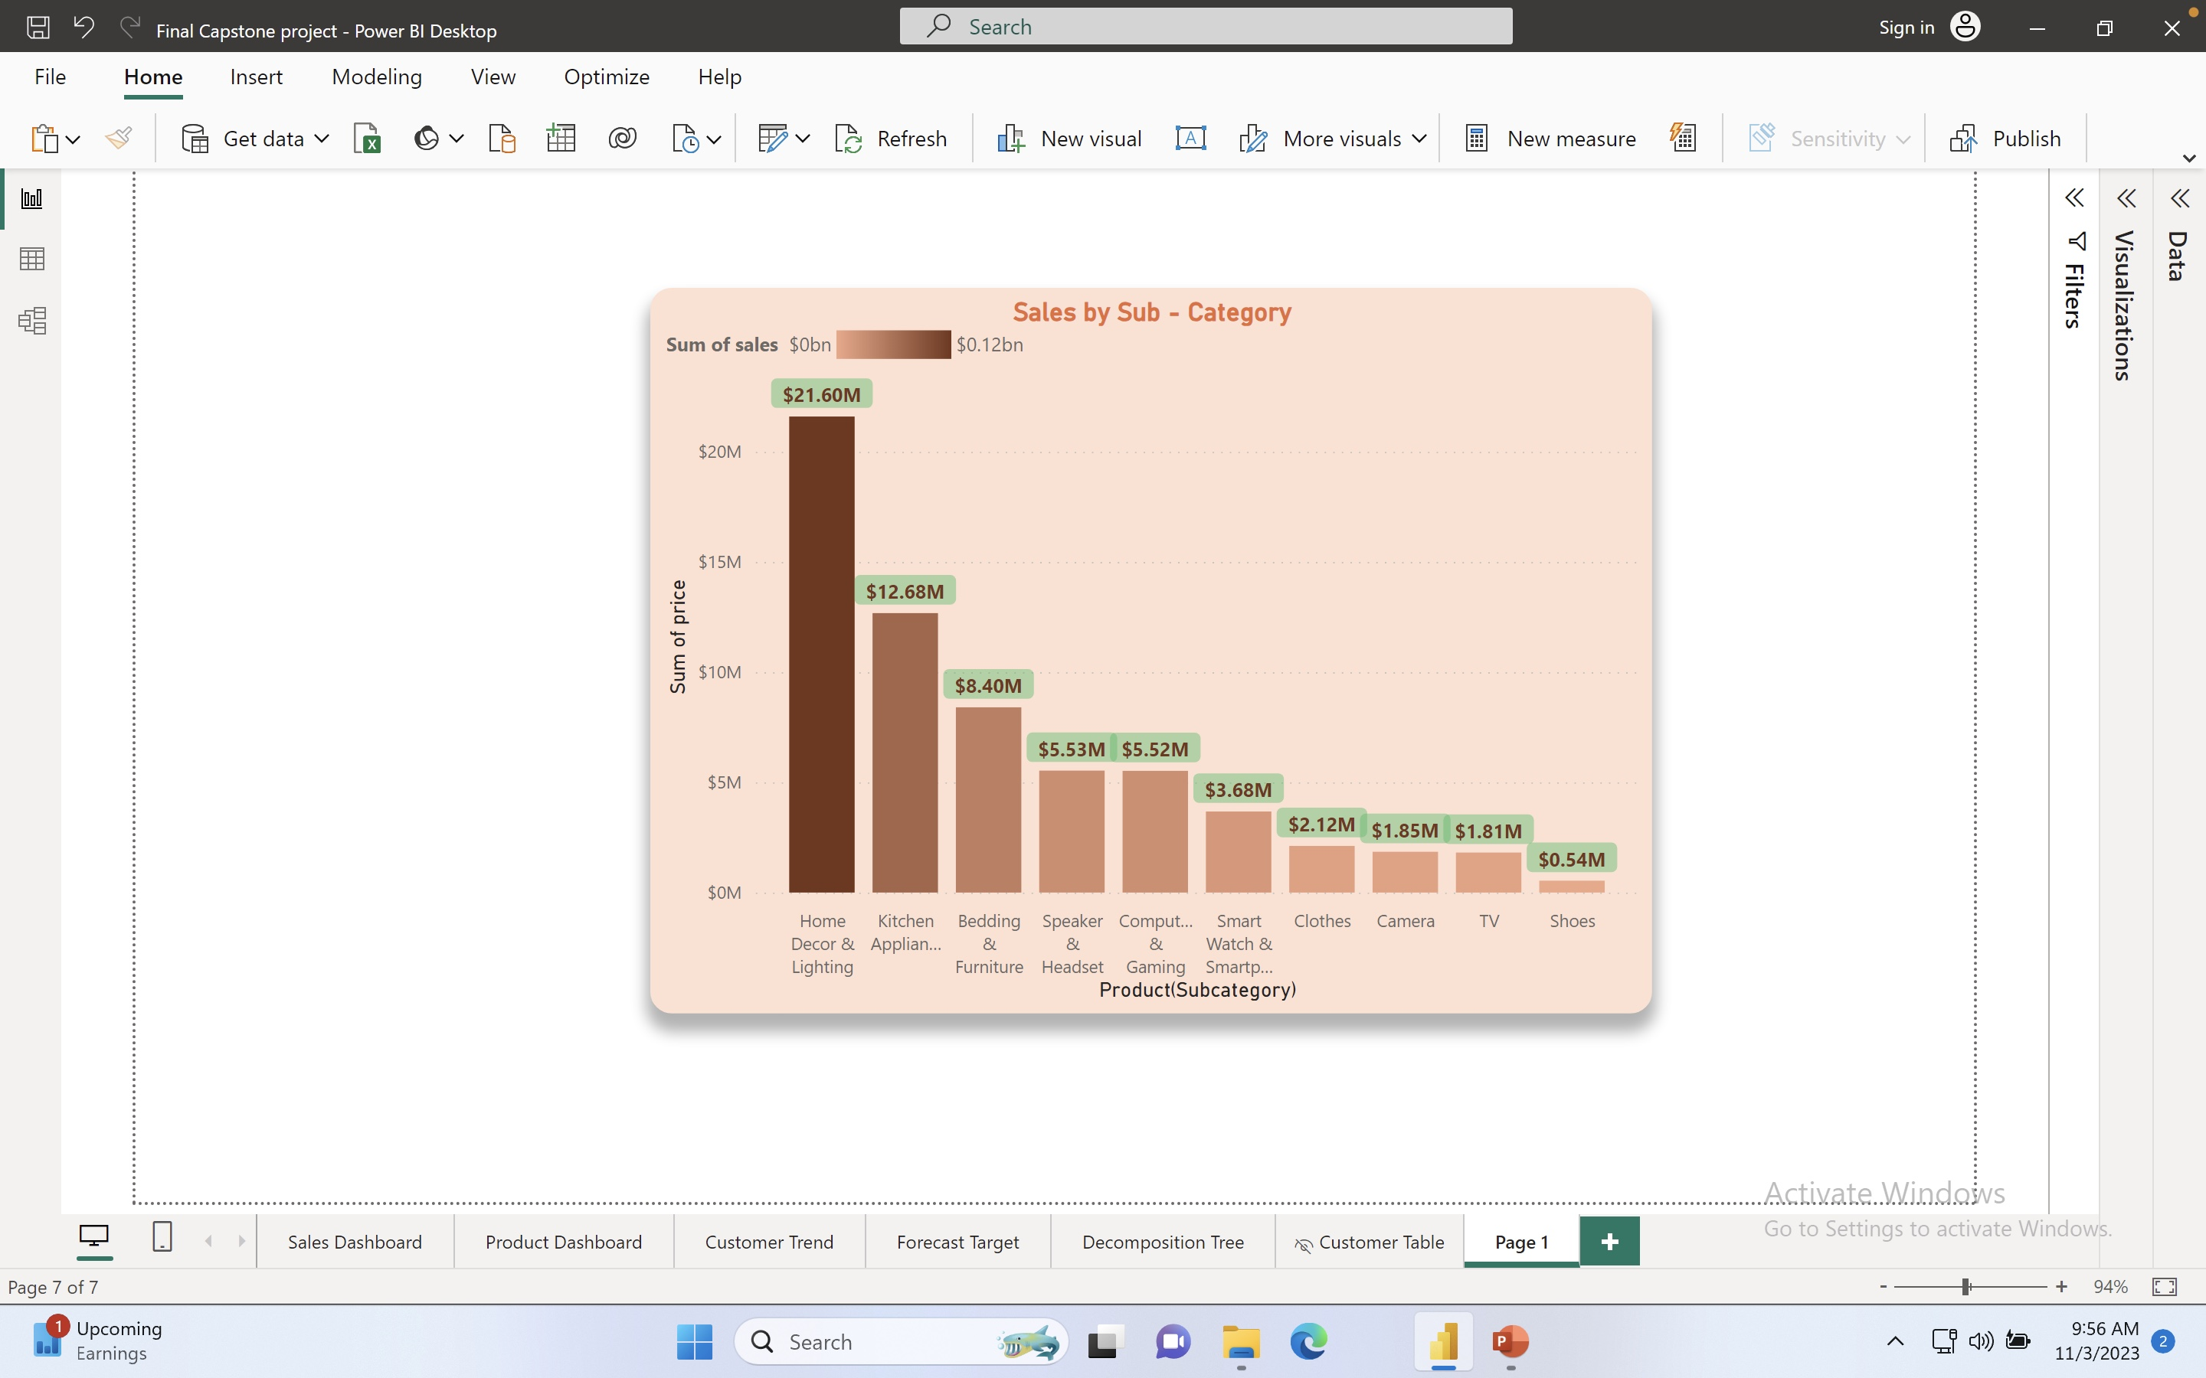
Sales By
Product
Sub-category
Breaking down in Sub-category
For better understanding
01
Home & Décor is the highest in terms of sales by sub-category
02
Lowest sales comes from Shoes

Slide 19
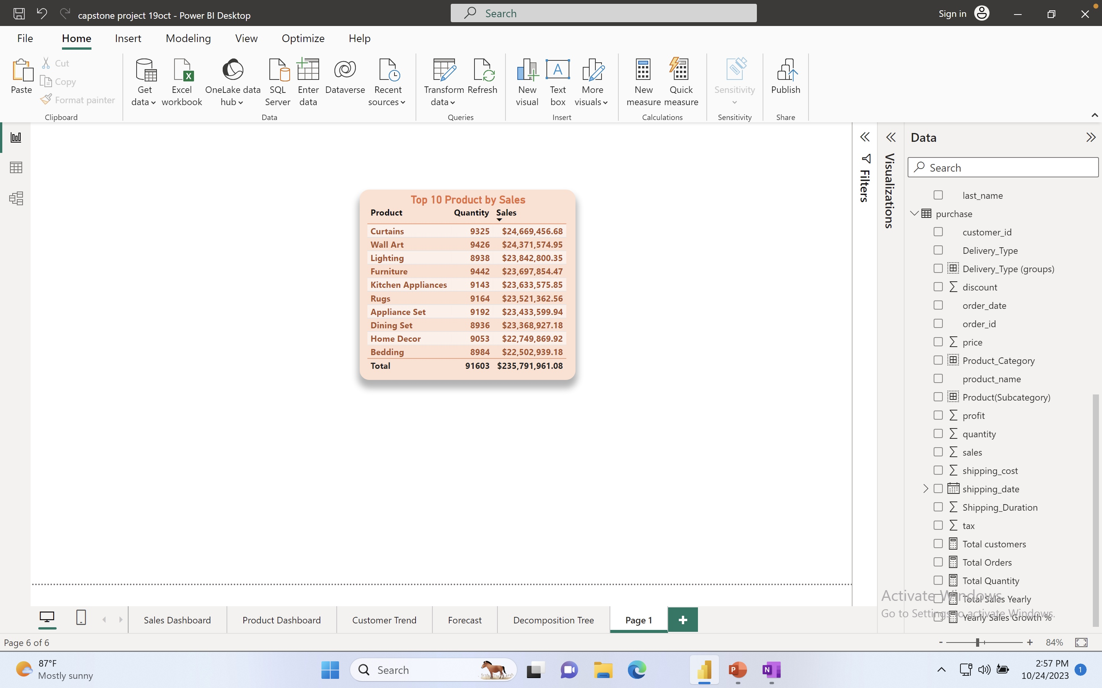
Top 10 Products
From Sub-Category which product is the best-selling?
01
1st Curtains has the highest sales with almost 25 million
02
Top 10 products mostly make up for home & living items.

Slide 20
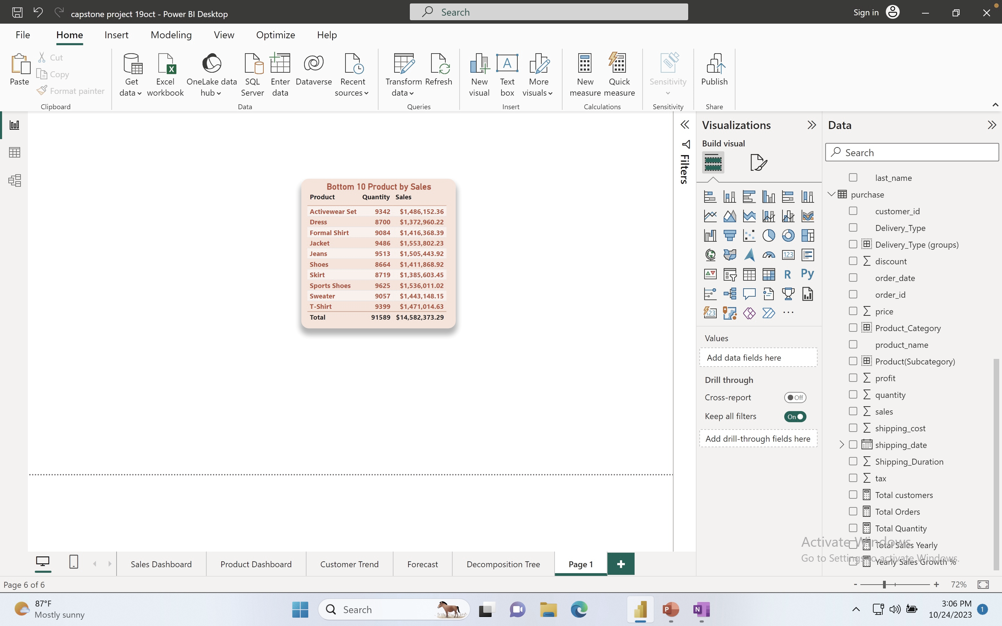
Bottom 10 Products
Which product brings in the least amount sales ?
01
T-shirt makes the lowest amount of sales
02
Appareals overall make the lowest amount of sales

Slide 21
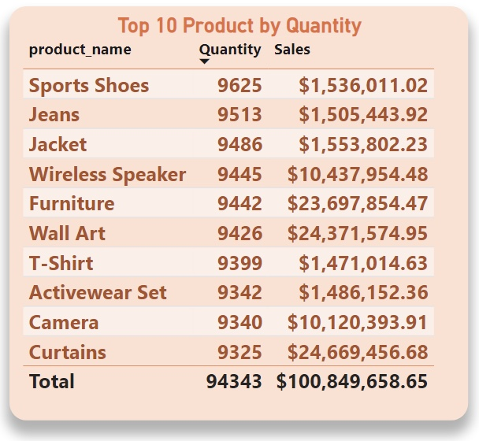
Sales vs Quantity
Does highest sales always bring in the highest quantity of product sold?
01
02
03
Home appliances has
Highest Sales
But Sports shoes , Jeans and jacket from Apparels
Has the highest Quantity sold.
Apparels has the lowest
Amount of sales

Slide 22

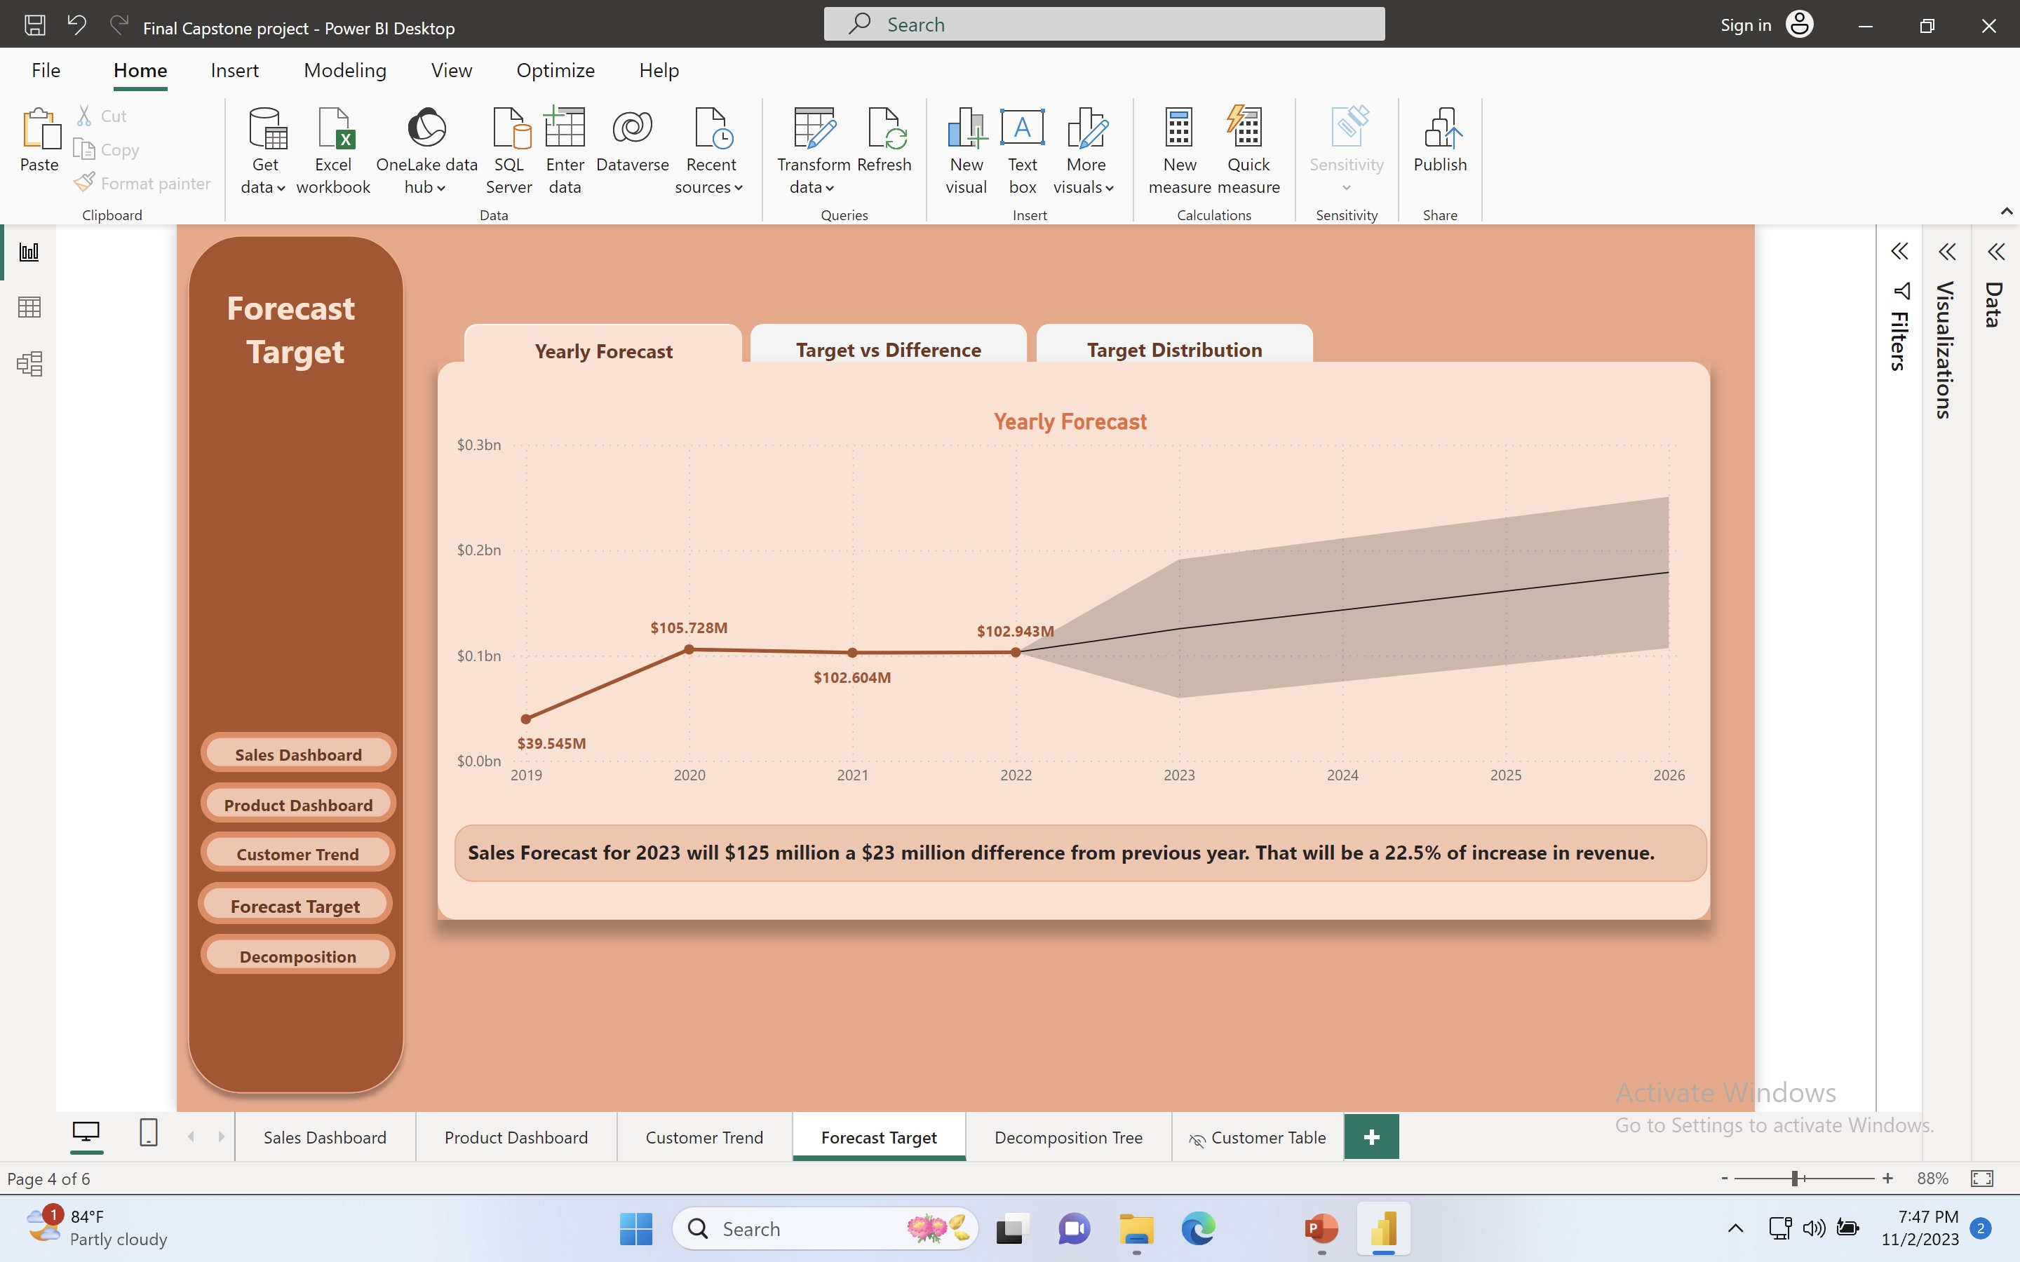
Yearly Forecast
What will be the forecast for 2023?

Slide 23
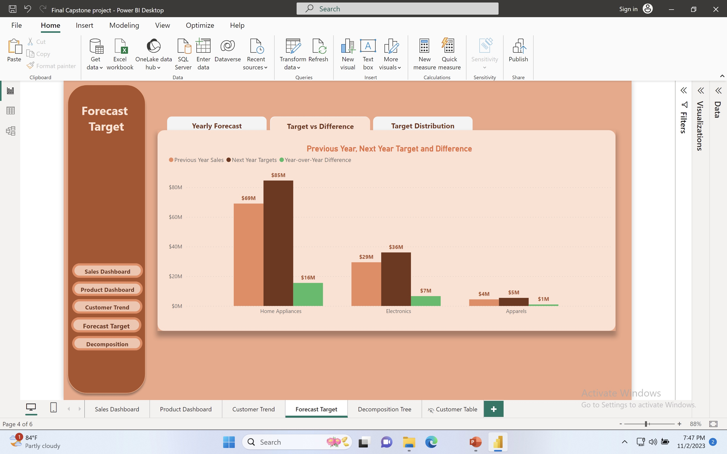
Target vs Difference
What will be next year target ?
Home Appliances
$16 million target
Electronics
$7 million target
Apparels
$1 million target

Slide 24
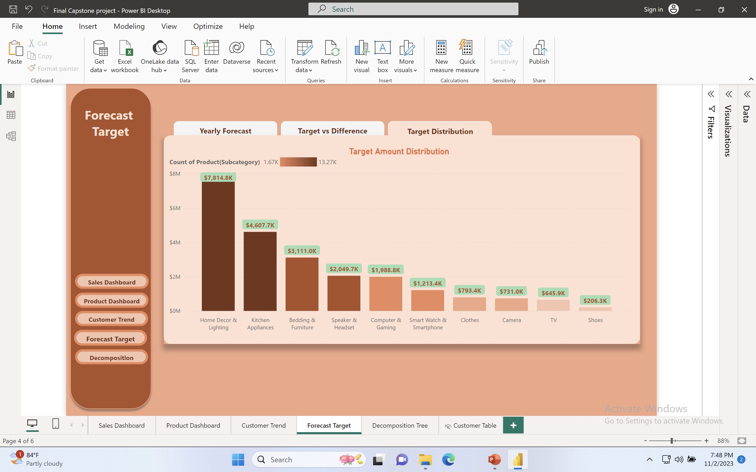
Target Distribution
How can we distribute sales target with the Sub-Category group?

Slide 25


Let’s conclude
Product by Age Group
Let’ Recommend Product Category to certain age group more.
Marketing executives can focus on specific Product Category for this Age group.
Home Appliances is the highest among (51-65) & (19-30).
Electronic Products sale is highest among (31-40). But it’s the 2nd best
Selling group in 3 age group. So, on average its sales is still good.
KPI # 1
For 41 – 50 age group buy more on apparels

Slide 26
Let’s conclude
Most Product by sales
Highest sales is from Home Appaliances from Category
We can get more vendors for Home Appliances and recommend
Add – on products because most customers are from this category so it will be another additional marketing source as it has the most sales already. Customer have buying power.
Home Décor & Lighting has the highest sale in sub-category
From sub-category we now know that home décor and lighting
Has the highest volume of sales. We could do a in-house brand or get bulk products to warehouse to cut
Cost and get more profit.
KPI # 1

Slide 27
Let’s conclude
Product with most Quantity.
Products with highest Quantity is from Sports shoe, Jeans and jacket.
Even if this 3 items don’t make the highest amount of sales
They have the highest quantity sold.
This product search has high number of traffic, SO WE CAN USE THE TRAFFIC TO UPSELL MORE PREMIUM CLOTHES,
LIKE LUXURY BRANDS- GUCCI,PRADA,LV AND MORE.
Currently, they have highest quantity of customers but lower sales. By introducing more Luxury clothes for this group can have higher amount of sales.
KPI # 1

Slide 28




Any QUESTIONS?
Capstone
Project
24 oct 2023

Slide 29
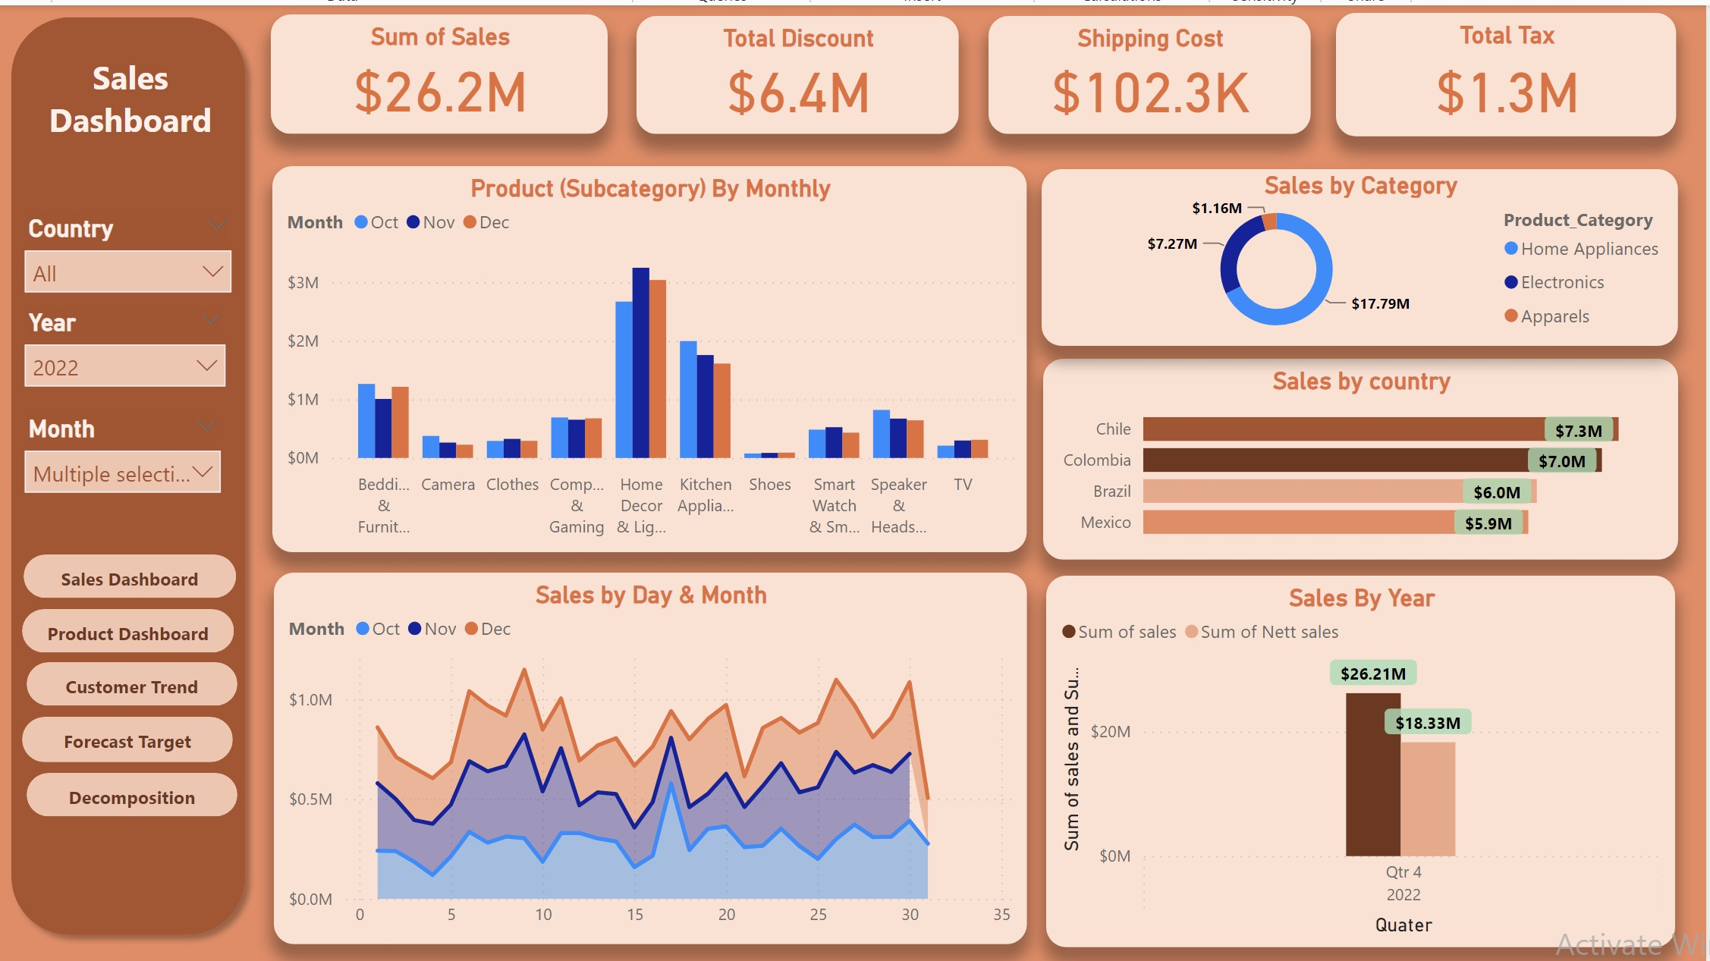
Capstone
Project
24 oct 2023

Slide 30
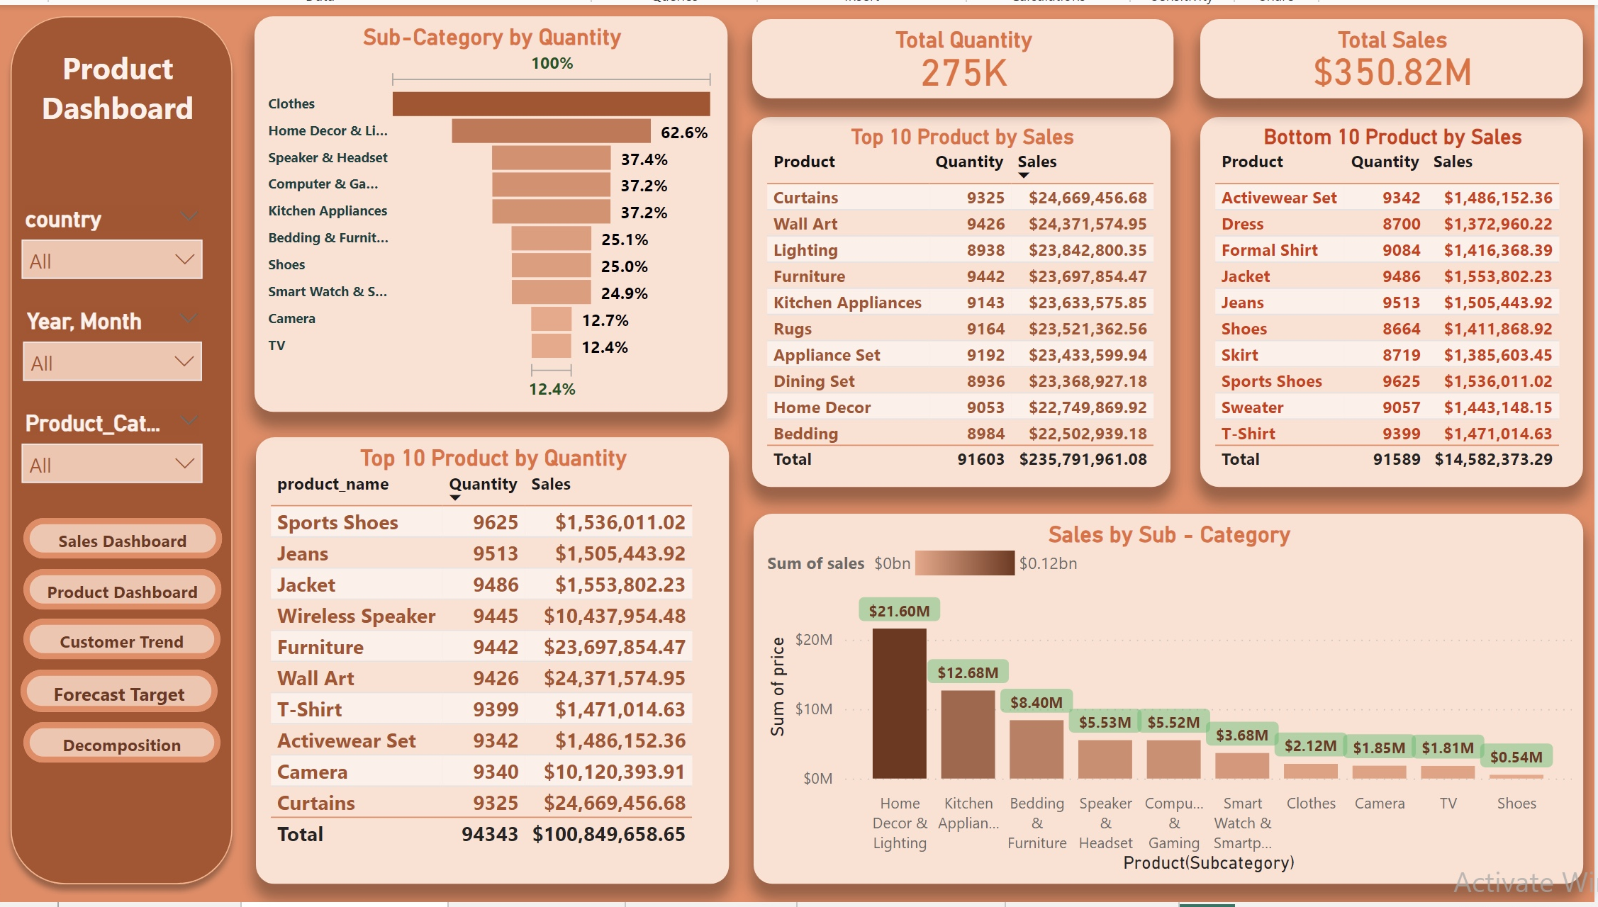
Capstone
Project
24 oct 2023

Slide 31
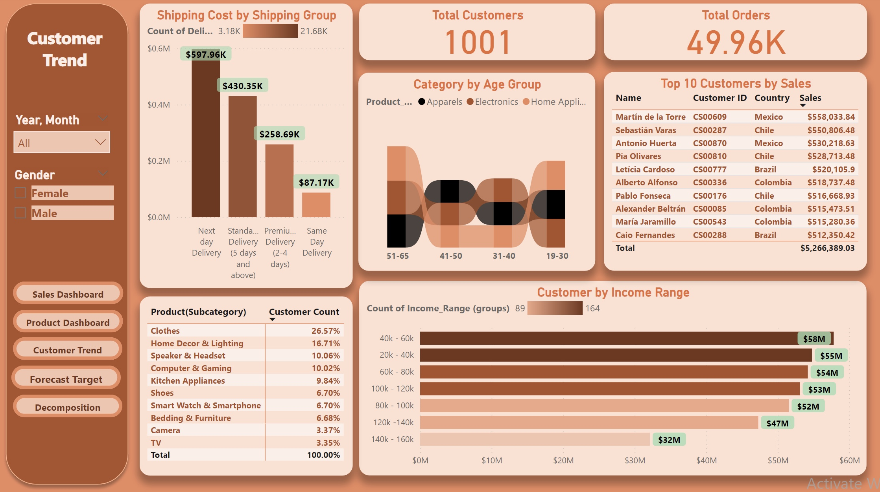
Capstone
Project
24 oct 2023

Slide 32
Capstone
Project
24 oct 2023

Slide 33
Capstone
Project
24 oct 2023

Slide 34
Capstone
Project
24 oct 2023

Slide 35
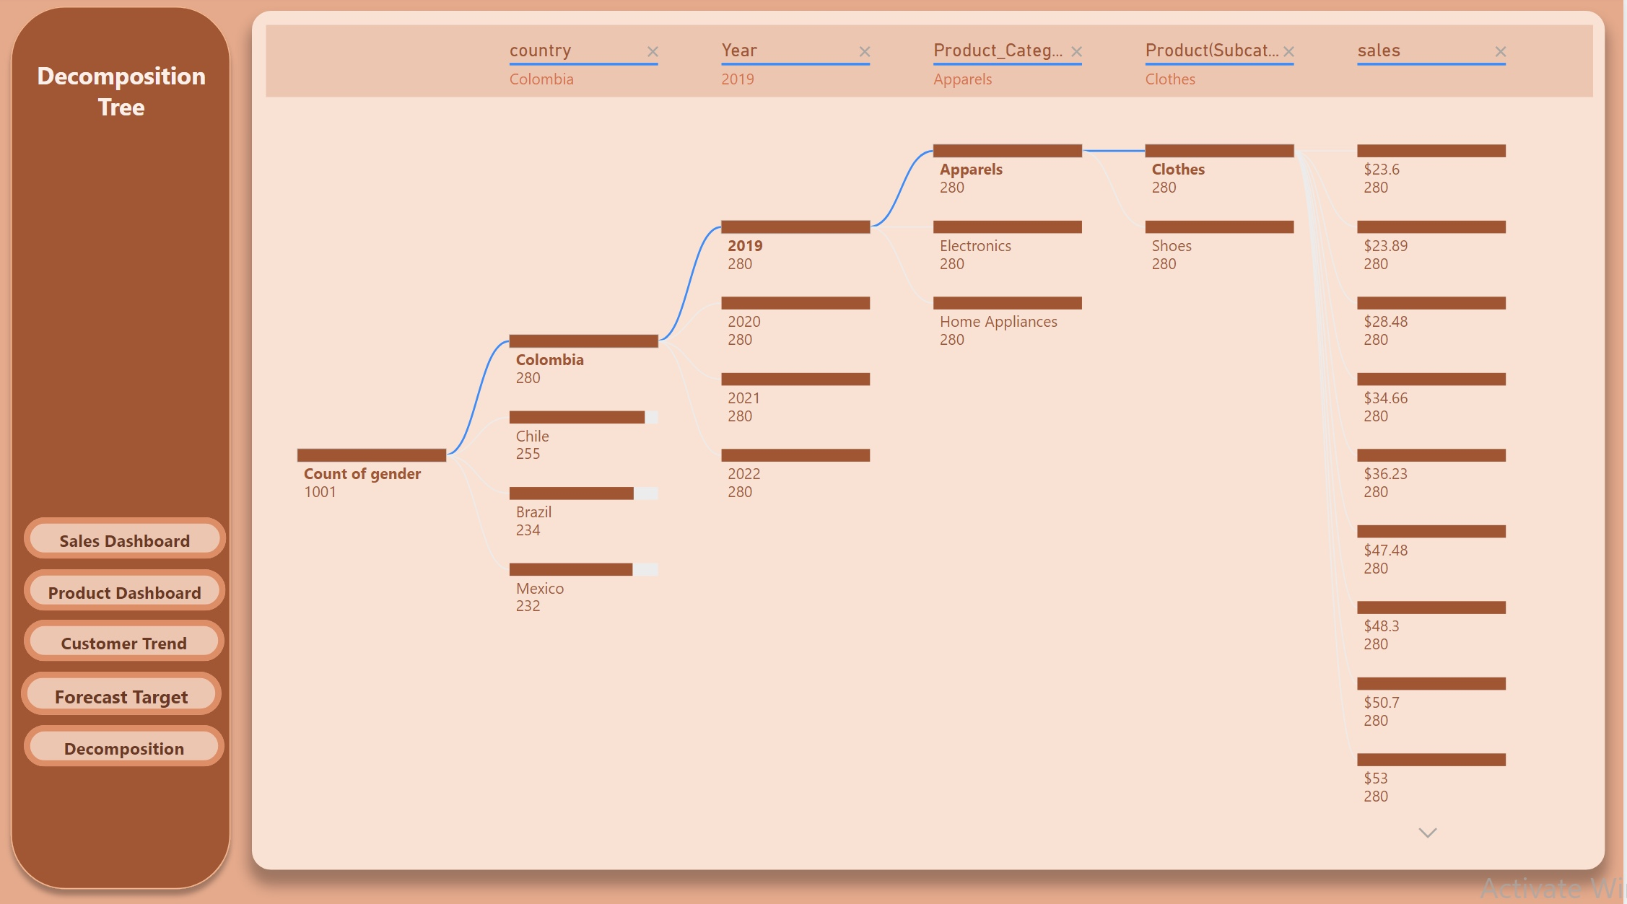
Capstone
Project
24 oct 2023

Slide 36
Thank
You
Capstone
Project
24 oct 2023

